Slide 1
Effect of GAN-Augmented Data on CNN Training
EE583 TERM PROJECT
Yunus Emre Tüysüz

Slide 2
Introduction
Generative Adversarial Networks
What papers does
Models
Simulation Environment
Results & Discussion

Slide 3
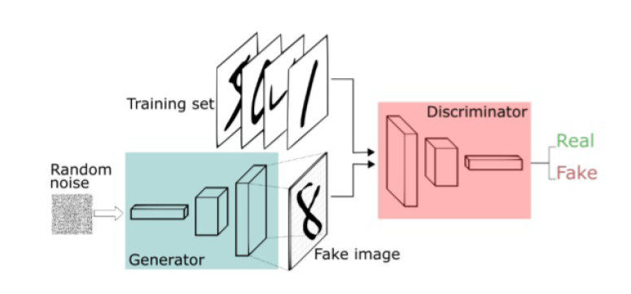
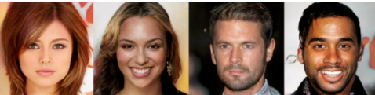
Generative Adversarial Networks
Ian Goodfellow 2014
2 neural networks: Generator, Discriminator
Networks compete in a zero-sum game framework

Slide 4
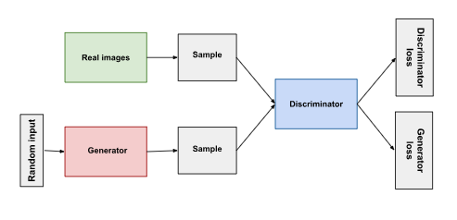
Generative Adversarial Networks
How GAN’s Work
Generator: Produces image resembling real data using noise (from image, signals for some applications)
Discriminator: Evaulates data whether it is fake or not
Both networks improve through adversarial training

Slide 5
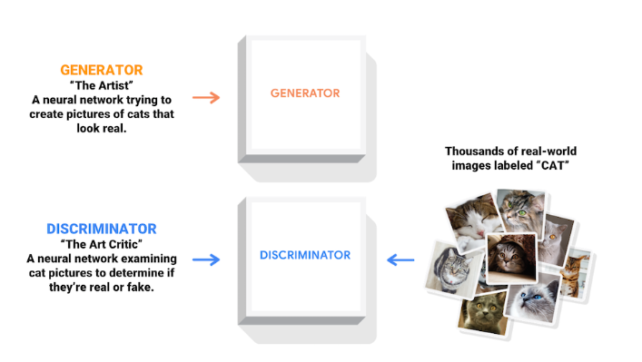
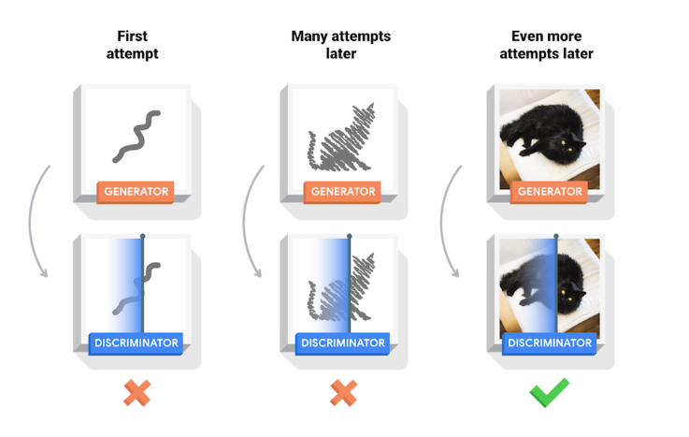
Generative Adversarial Networks

Slide 6
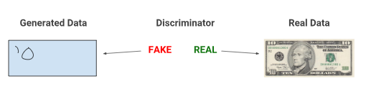
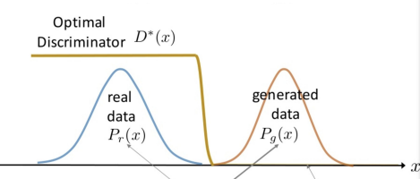


Generative Adversarial Networks

Slide 7
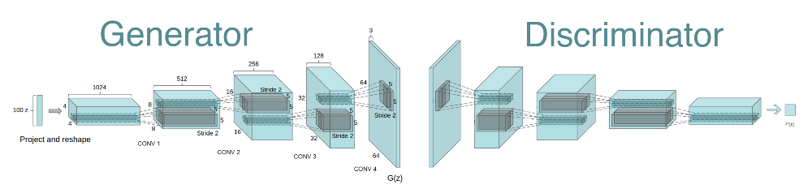
DCGAN
Deep Convolutional GANs (DCGANs) are a variant of GANs that integrate convolutional and transposed convolutional layers to handle image data
Applications:
Unsupervised representation learning.
Image generation and editing.
Feature learning for classification tasks

Slide 8
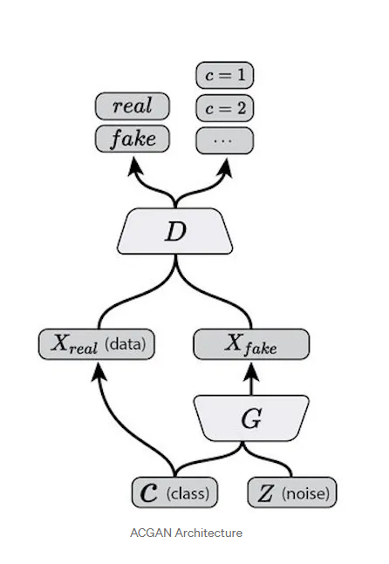
ACGAN
ACGANs aim to improve the quality and diversity of generated images by conditioning on class labels.
Applications:
Class-conditional image synthesis.
Data augmentation for imbalanced datasets.
Generation of labeled synthetic data for training classifiers.

Slide 9
Articles
Their aim is to improve the classifier accuracy using smaller datasets using GAN’s
Problem: Small datasets cause overfitting and lack diversity, reducing classifier accuracy.
Solution: Use Generative Adversarial Networks (GANs) to:
Generate high-quality synthetic data.
Enhance dataset size and diversity.
Outcome: Improved generalization and accuracy, even with limited original data.

Slide 10
Models & Simulation Environment
For models, I inspired by Hou et al.'s "Conditional GANs with Auxiliary Discriminative Classifier" [2].
For training code, I inspired by B. Chao's "Anime-Generation" GitHub repository [4].

Slide 11
Results and Discussion
The models implemented using 3 different datasets:
Ultrasound images
MNIST
CIFAR10
For MNIST and CIFAR10:
Number of samples used as a variable.
SVM is also applied.

Slide 12
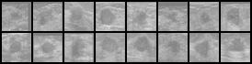

Ultrasound
250 images; 200 for training, 50 for testing.
Model | Accuracy
GAN-augmented CNN | 96%
Standalone CNN | 68%
Model | Accuracy
Proposed [1] | 98.80%
Resnet-18 | 95.60%
VGG16 | 95.60%
VGG19 | 96.40%

Slide 13
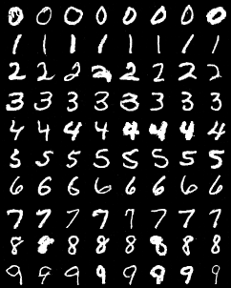
MNIST
Model | Number of samples used for training | Accuracy
GAN-augmented CNN | 5000 | 98.12%
Standalone CNN | 5000 | 97.16%
GAN-augmented CNN | 60000 | 98.50%
Standalone CNN | 60000 | 98.97%
SVM | 10000 | 40.8%

Slide 14
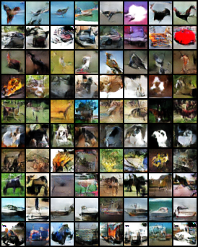
CIFAR10
Model | Number of samples used for training | Accuracy
GAN-augmented CNN | 500 | 39.26%
Standalone CNN | 500 | 34.67%
GAN-augmented CNN | 5000 | 72.88%
Standalone CNN | 5000 | 53.65%
GAN-augmented CNN | 50000 | 72.59%
Standalone CNN | 50000 | 67.55%
SVM | 50000 | 18.7%

Slide 15
Conclusion
Study Overview:
Evaluated classification methods and data augmentation on datasets: Ultrasound, MNIST, CIFAR-10.
Compared traditional SVM, CNN, and GAN-augmented CNN approaches.
Key Findings
GAN-augmented CNNs are effective when the dataset is limited.
As the dataset gets larger, the importance of GAN diminishes.
Traditional solutions like SVMs are not a good way to classify images.

Slide 16
THANK YOU FOR LISTENING

Slide 17
References
[1] S. Saha and N. Sheikh, “Ultrasound Image Classification using ACGAN with Small Training Dataset,” arXiv.org, 2021. https://arxiv.org/abs/2102.01539.
[2] L. Hou, Q. Cao, H. Shen, S. Pan, X. Li, and X. Cheng, “Conditional GANs with Auxiliary Discriminative Classifier,” arXiv.org, 2021. https://arxiv.org/abs/2107.10060.
[3] A. Waheed, M. Goyal, D. Gupta, A. Khanna, F. Al-Turjman, and P. R. Pinheiro, “CovidGAN: Data Augmentation using Auxiliary Classifier GAN for Improved Covid-19 Detection,” IEEE Access, pp. 1–1, 2020, doi: https://doi.org/10.1109/ACCESS.2020.2994762.
[4] I. J. Goodfellow et al., “Generative Adversarial Networks,” arXiv.org, Jun. 10, 2014. https://arxiv.org/abs/1406.2661
[5] B. Chao, "Anime-Generation," GitHub repository, https://github.com/bchao1/Anime-Generation.

